Slide 1
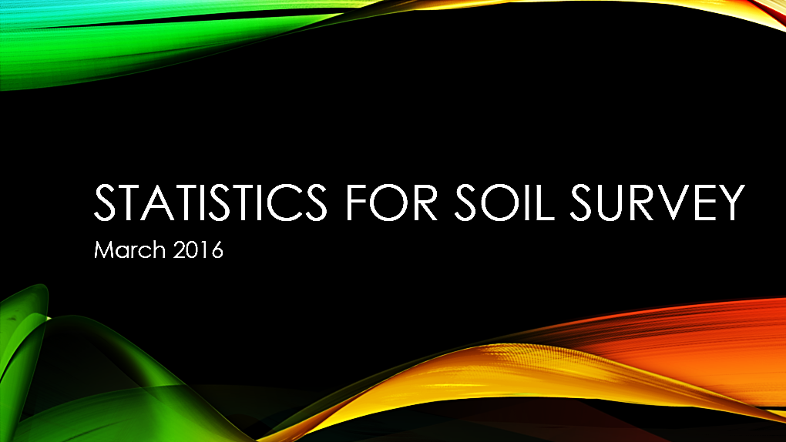

Slide 2
Welcome!
Introductions
Pre-course Questionnaire
Course Objectives
Overview
Pre-course assignment
History of the NASIS database
Introduction to R and RStudio
Installing packages in RStudio
Establishing an ODBC to NASIS

Slide 3
Introductions
Name
Job Title
Location
Something Interesting About Yourself

Slide 4
Pre-course Questionnaire
MLRA and RO Staff
Years of Service with NRCS
Minimum – 8 months
Mean – 16.6 years
Maximum – 36 years
Current Workload
SDJR
PESD
ESD
SDQS (initial, update, SDJR)
Mapping (initial, update, extensive)
GIS

Slide 5
Pre-course Questionnaire: Statistics/Statistical Techniques Used
Descriptive statistics (mean, median, mode, maximum, sd, etc.)
Excel
Zonal Statistics in ArcMap
Histograms
Stratified Sampling
Quartile approach using the AQP package in R
Clustering

Slide 6
Pre-course Questionnaire: Current Soil Survey Procedures
Mapping: dominantly heads-up digitizing guided by terrain derivatives and climate data; one office is performing supervised classification where previous line-work is used to train the model
Software: ArcMap, ArcSIE, TEUI, PedonPC, MobilMapper, R, custom NASIS reports, Excel

Slide 7
Pre-course Questionnaire: What You Want From this Course
Become more familiar with R
Exposure to statistics
Learn how to analyze data efficiently
Digital soil mapping applications
Tools for building a case for updating old soil surveys
Learn useful tools for PESD development, clustering pedons, and data aggregation
A visual diagram of data sources, tools, and processes for soil survey
Learn how to apply statistical methods within the realm of soil survey and its implications on soil survey standards

Slide 8
Course Objectives
Develop solutions to investigate soil survey correlation problems and update activities.
Evaluate investigations for interpretive results and determine how to proceed.
Create a continuous surface from point data.
Summarize data for population in NASIS.

Slide 9
Overview: Why Is This Training Needed?
Long standing goal of the Soil Science Division to have a course in statistics
Opportunities to learn these techniques are limited, especially at the undergraduate level
Consistent methodology (data analysis, data population, sampling design, etc.)
There is continually a greater need to use these techniques:
Mapping of unmapped federal lands via digital soil mapping techniques
Ecological Sites
Soil survey refinement (disaggregation)

Slide 10
Overview: Week 1 (online)
Day 1
Introduction
Pre-course Assignment
Data We Use
Day 2
Sampling Design
Exploratory Data Analysis
Day 3
Exploratory Data Analysis
Clustering and Ordination

Slide 11
Overview: Week 2 (NSSC)
Day 4
Week 1 Review
Linear Regression
Logistic Regression
Day 5
Tree Models
Validation and Uncertainty
Day 6
Course Review
Final Project

Slide 12
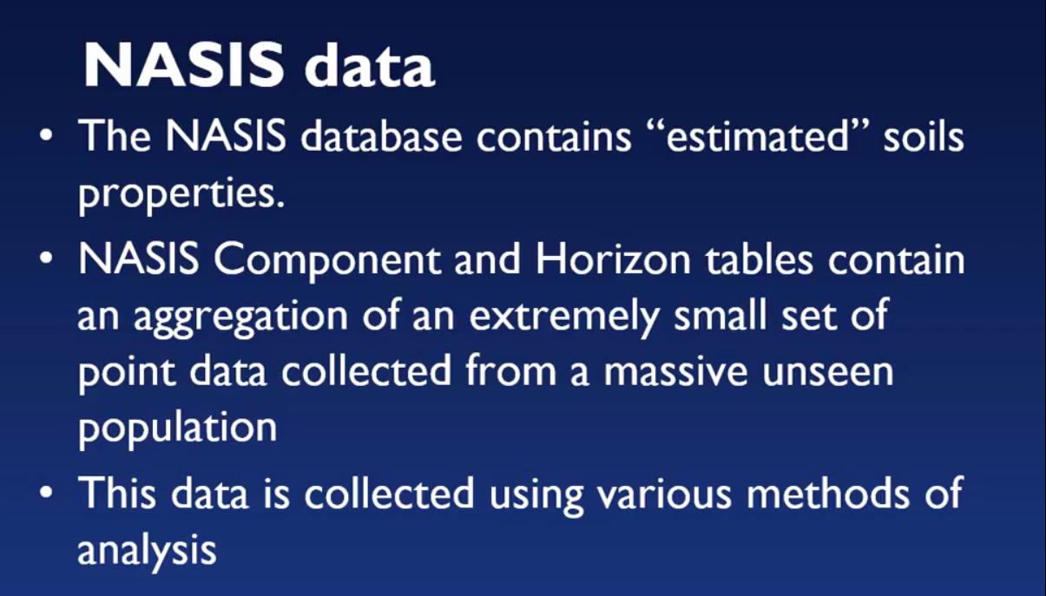
Pre-course Assignment: History of NASIS
Notes:
In Paul’s Youtube lecture, he discussed the difference between estimated and analyzed soil properties and presented an example of the importance of site selection. We as soil scientists have to extrapolate knowledge gained from a small set of point data to very large, unseen areas.

Slide 13
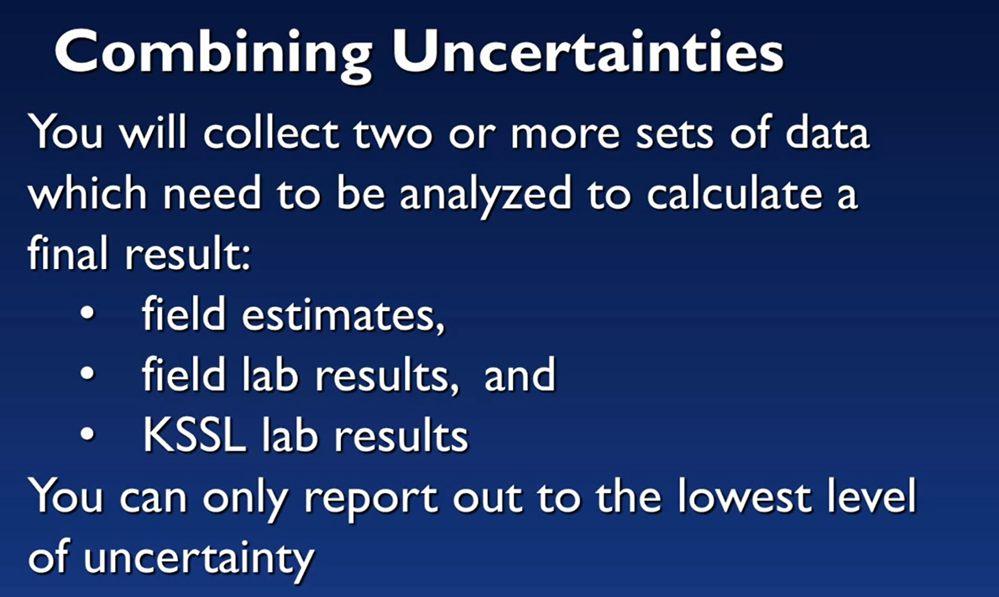
Pre-course Assignment: History of NASIS
Notes:
You should only populate NASIS with the lowest level of certainty, which is your field estimates. Do not populate NASIS with decimal points (lab precision/accuracy).

Slide 14
Pre-course Assignment: RStudio
In the pre-course assignment, we had you:
Set your working directory and verify RStudio version
Install packages
Establish an open database connection (ODBC) to NASIS

Slide 15
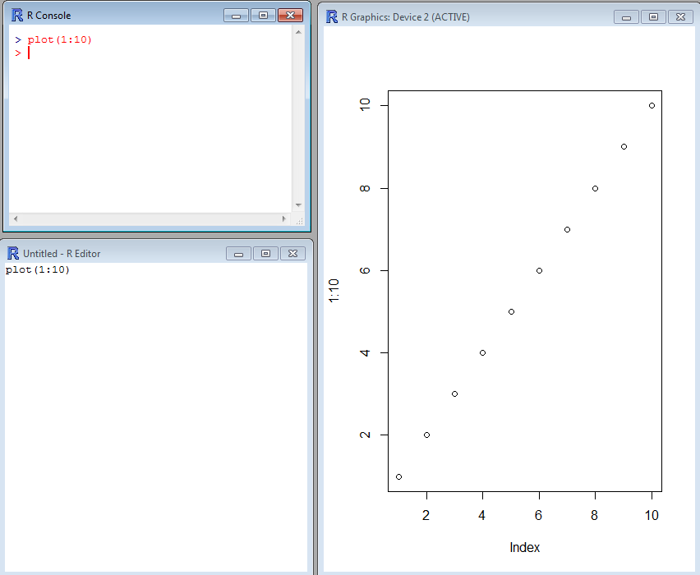
Introduction to R
R Console:
R code is typed here when it is ready to be executed.
R Graphics:
Graphics are displayed in this window after plot() or another graphics function is executed in R Console.
R Editor:
R code is typed here when it is in the process of being edited (you can also use notepad, notepad ++, etc.).
Notes:
There are two R that have been installed on your machine: R and RStudio. Both programs are command line driven and allow graphical display.
There are three main windows in R that you can use to conduct your data analysis: R Console, R Editor, and R Graphics. The R Editor window is simply a text editing window, you may also use notepad or notepad ++. The R Graphics window will only display when a command such as plot ( ) is executed.

Slide 16
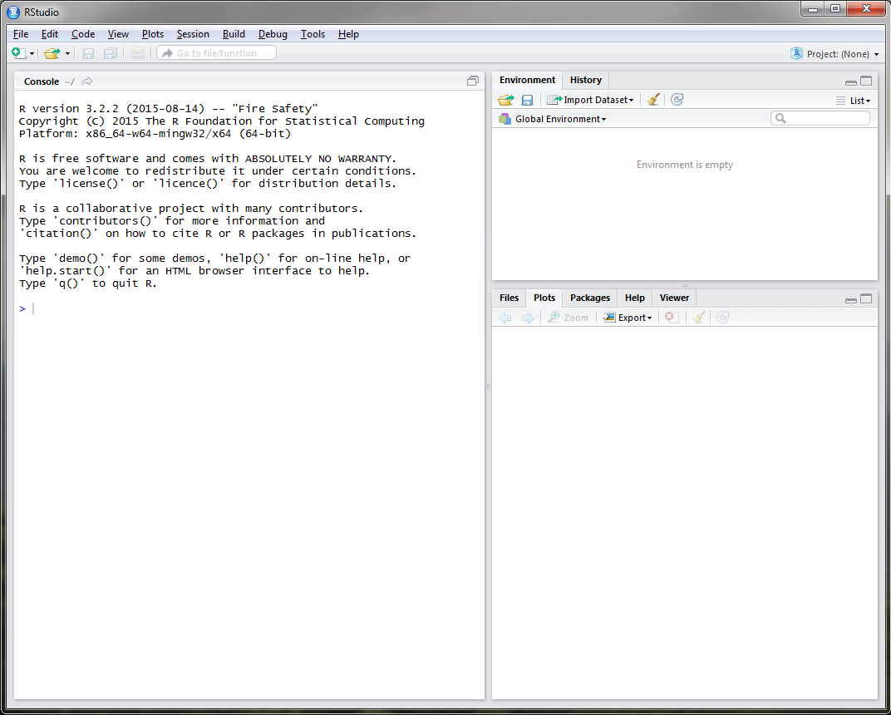
RStudio
Notes:
RStudio is similar to R GUI, but is more user friendly. When you open RStudio on your machine, you will see 3 windows: the console window, just like in the R GUI and two other windows composed of multiple tabs. The upper right window has two tabs: environment and history. The environment tab will allow you to import data and keep track of the data objects you create in R. The history tab keeps a record of all the commands that you execute. The bottom right window has 5 tabs: files, plots, packages, help, and viewer. The files tab allows you to navigate through folders similar to windows explorer. The plots tab will display and keep track of all of the plots that you generate. The packages tab allows you to install, load, and update packages using a GUI. The help tab allows you to search for documentation on R commands or packages. Unlike google, it will not allow you to search for things like cat sweaters or how to tie a tie. The viewer tab is for more advanced R users. We will not discuss it in this course.

Slide 17
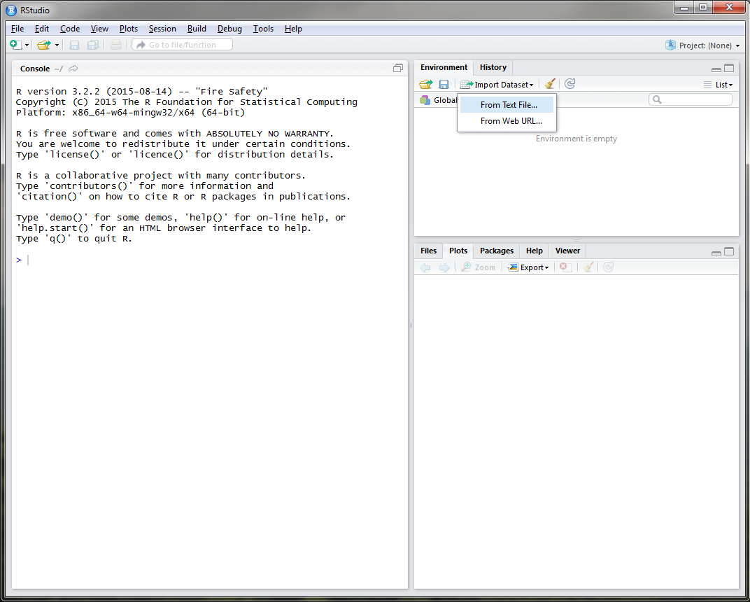
RStudio
Notes:
You can easily import data using the Environment tab.

Slide 18
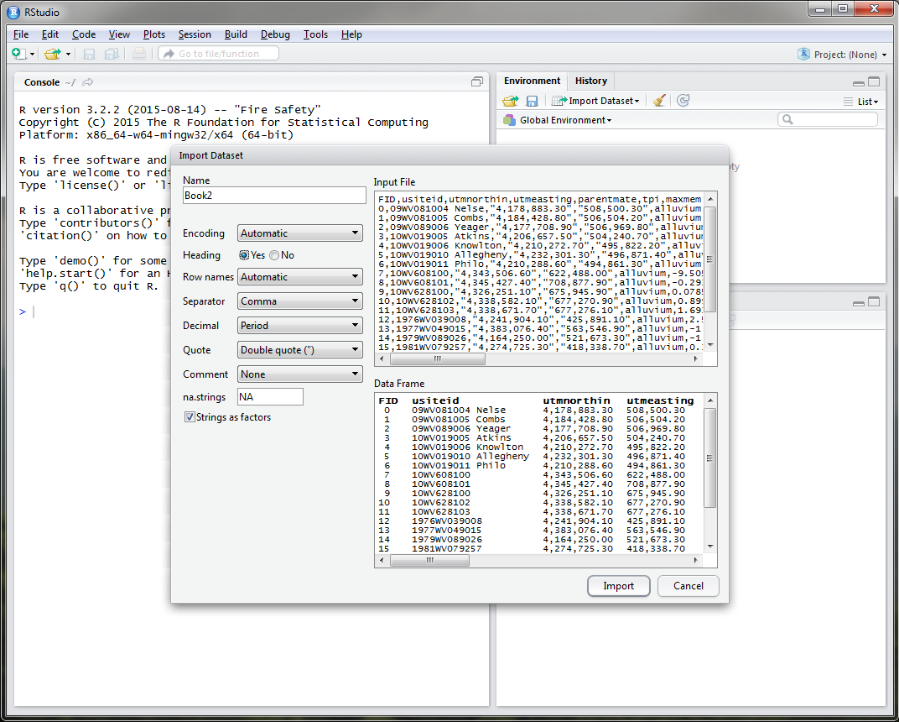
RStudio
Notes:
If you click import dataset, an import window similar to excel will appear.

Slide 19
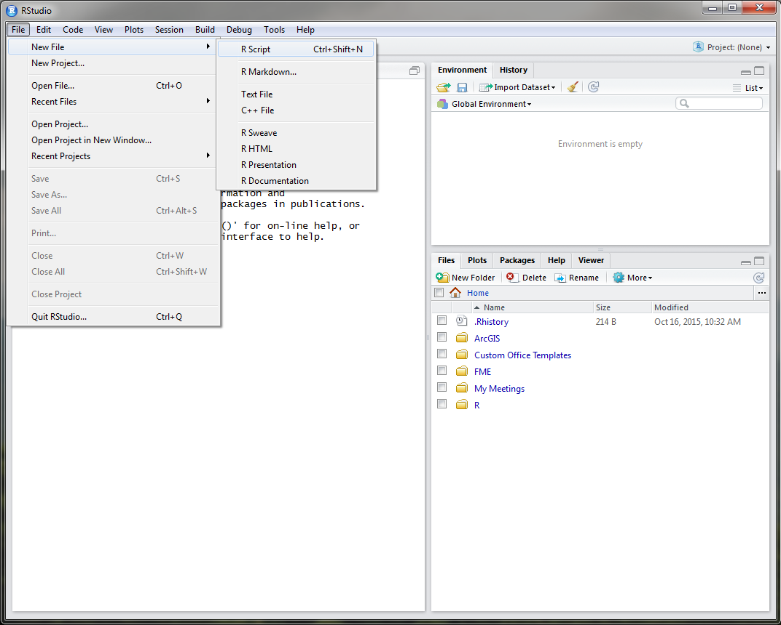
RStudio
Notes:
The text editor window, similar to R, can be opened in RStudio using the File drop down menu.

Slide 20
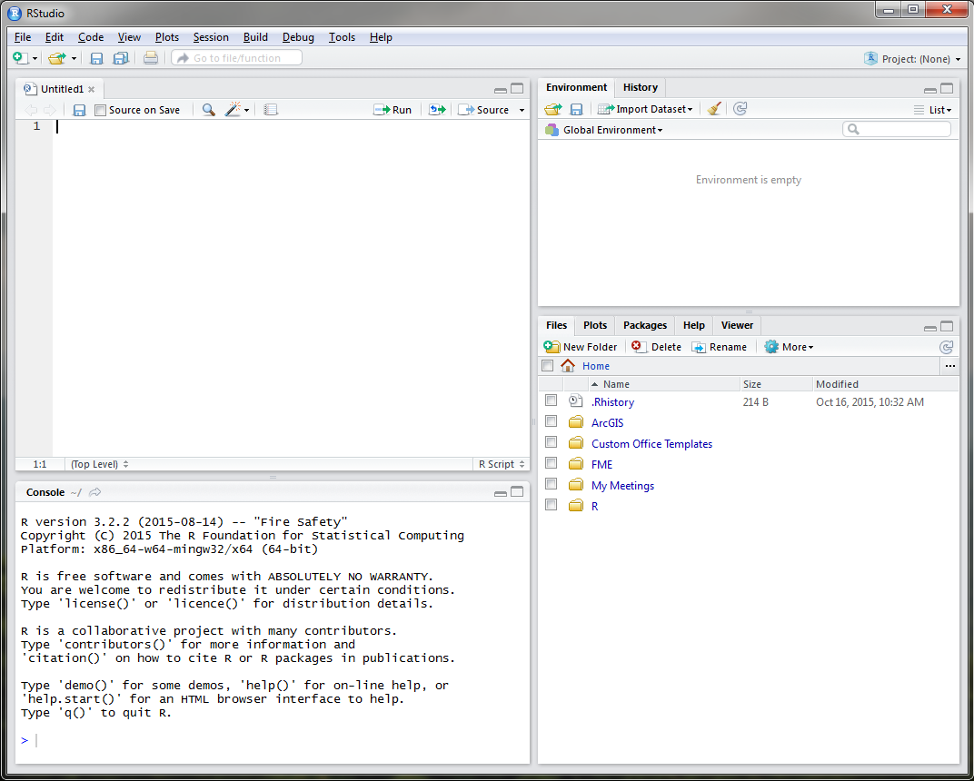
RStudio
Notes:
It is recommended to use the text editor window to develop your code before executing it in the console window.

Slide 21
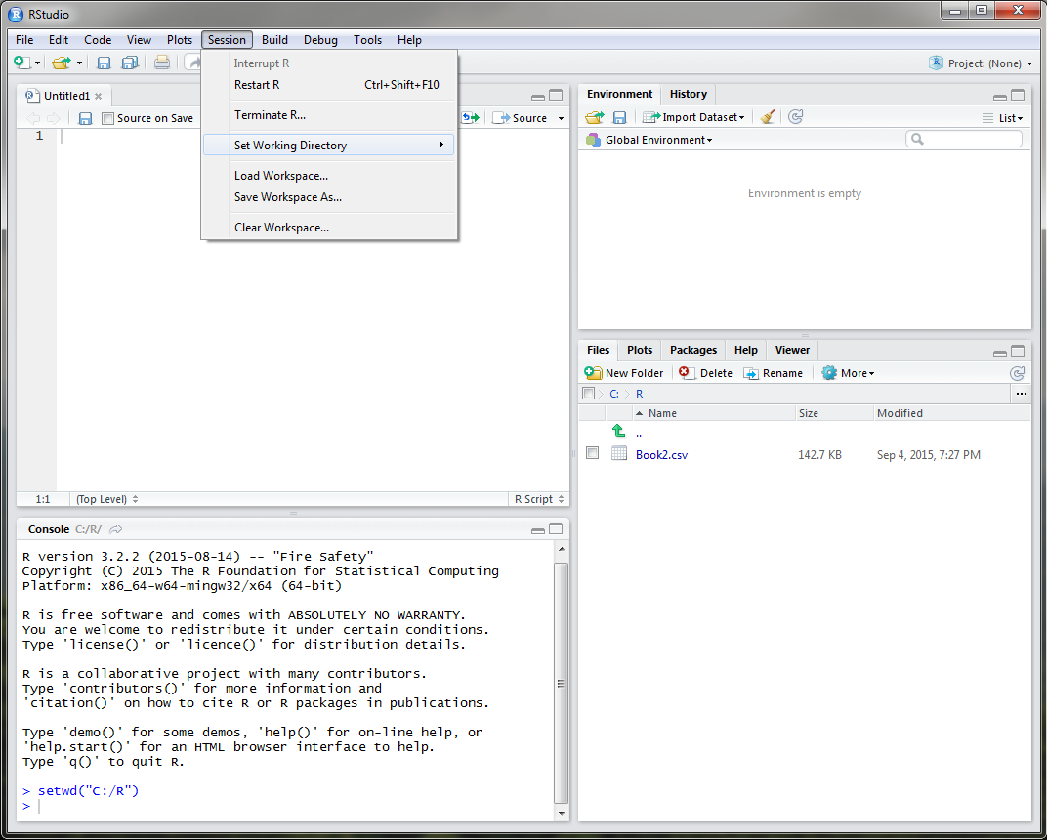
RStudio
Notes:
At the beginning of each R session, whether you are using R or RStudio, you want to make sure that you set your working directory. This directory should be where your input datasets are stored, R files are located, and will also serve as the default storage of plots or exported objects from R. To do this in RStudio, simply use the Session drop down menu. Notice that once you set your working directory, the Files tab in the bottom right window navigates to the directory that you specified, in this example, a folder called R on the C drive.

Slide 22
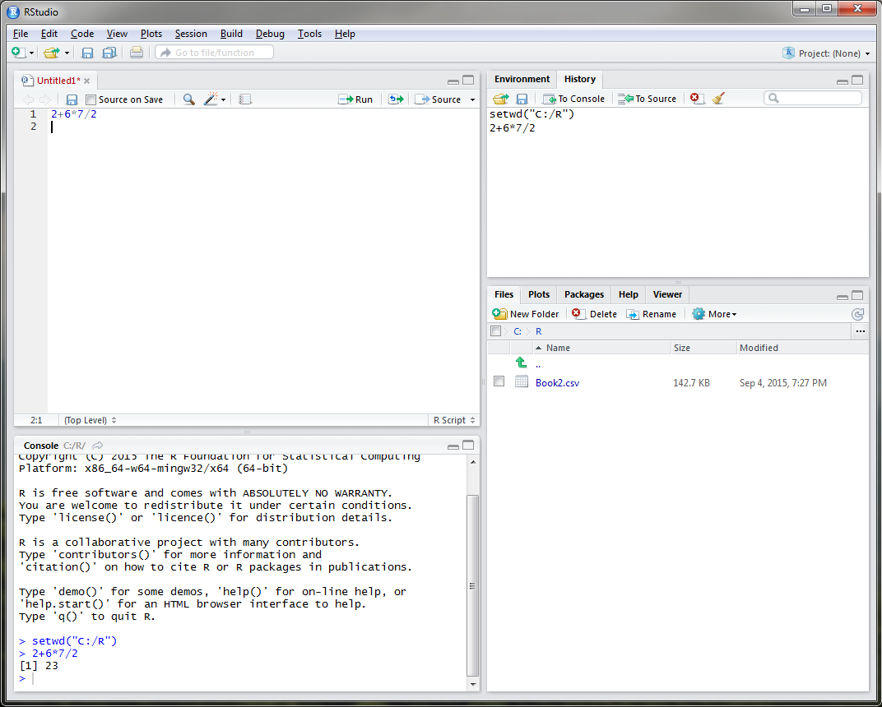
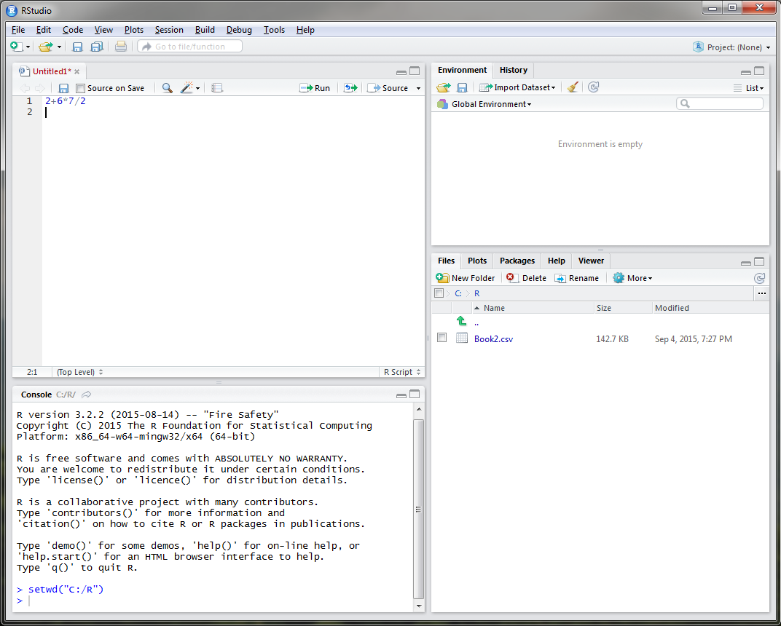
RStudio
Notes:
R can be used as a calculator to solve simplistic mathematical equations like the one currently displayed, as a GIS, for statistical analysis, for sampling design, and for modeling. In order to execute the equation that I have typed, I must place my cursor on line 1 or highlight line 1 and select the Run button.
-Click-
Notice that the answer to my equation is displayed in the console window in the bottom left and the command is added to the History tab.

Slide 23
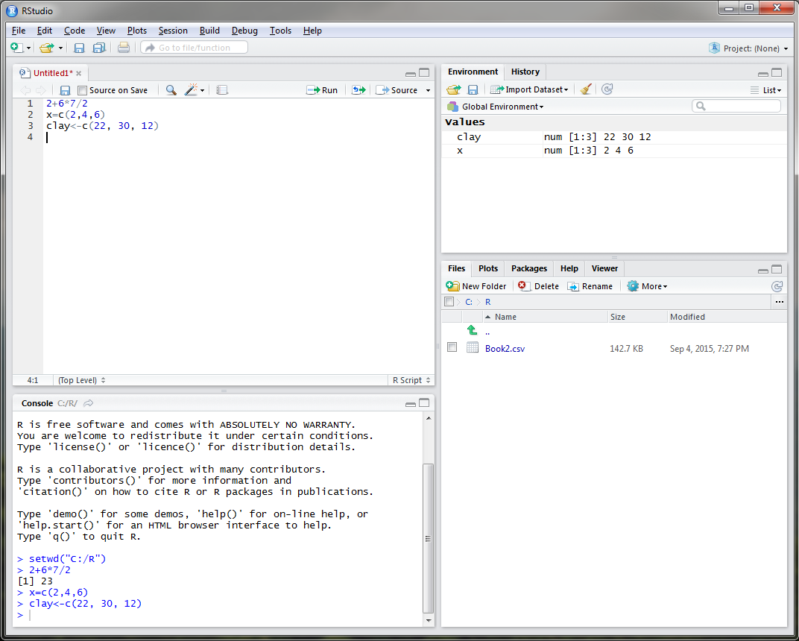
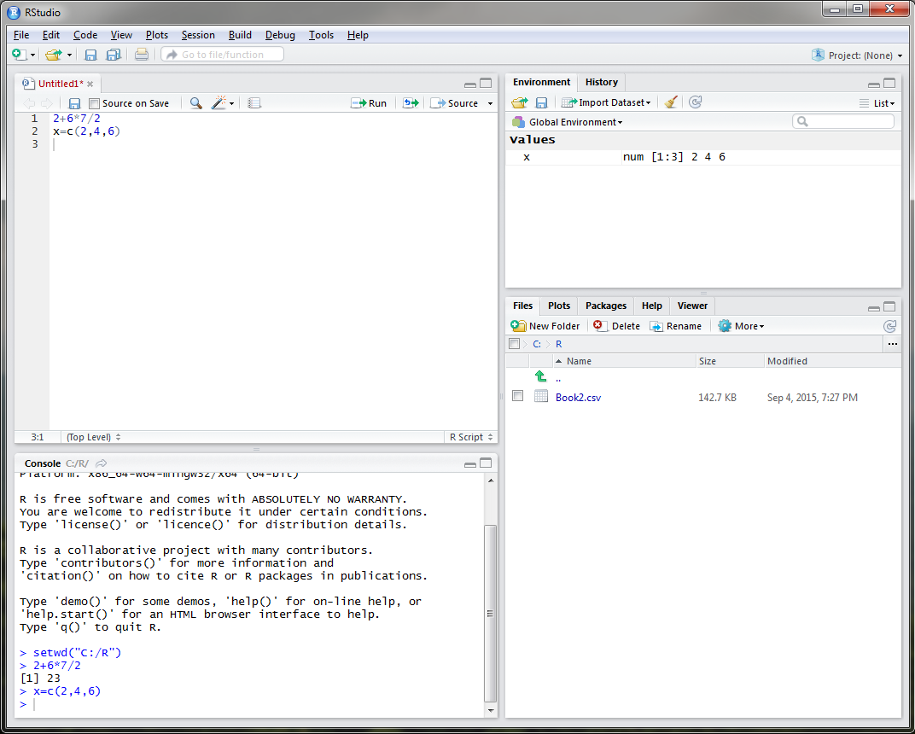
RStudio - Objects
object <- function
object = function
Notes:
In R you can assign almost anything as an object, including a single number or letter, model, settings, or dataset. For example, say I wanted to create an object entitled x that displayed rock fragment content of 3 different sites. I could do this in R by typing, x equals the concatenate function that links together the rock fragment values of 2, 4, and 6. Objects are displayed in the Environment tab in the upper right corner. In order to create an object in R, you must use either the = sign or a less than with a dash, either is fine. It is personal preference.
-Click-
Let’s create an object called clay to represent the clay content at these three sites.

Slide 24
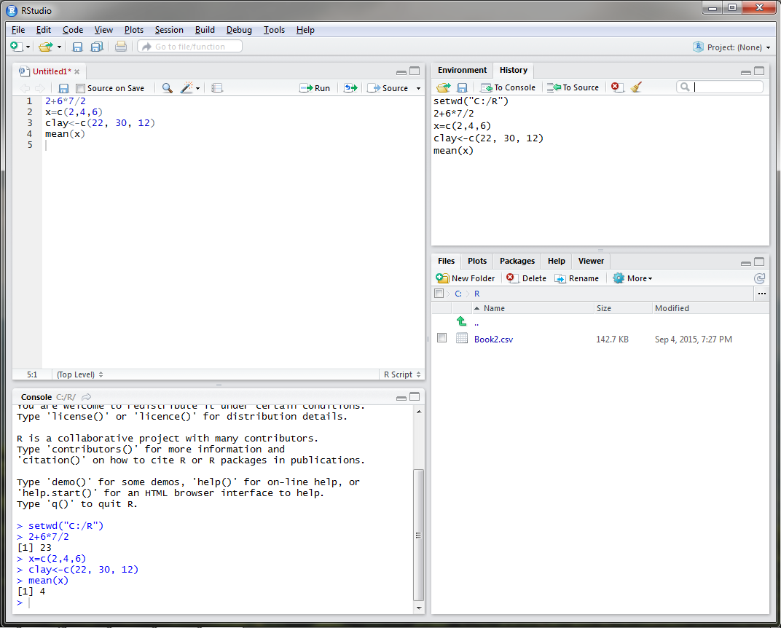
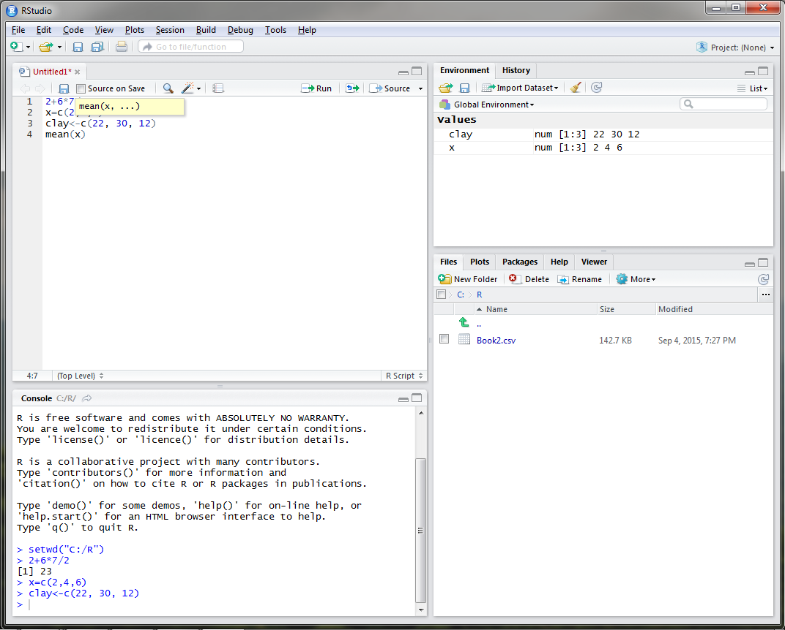
RStudio
Notes:
Say we wanted to know the mean of our rock fragment content. The function for mean is conveniently mean in R, so you would type mean with x (our rock fragment dataset) in parenthesis.
-Click-
Once you run this command, the answer is displayed in the console as 4 and the function is added to the R history tab. When you type a function in RStudio, a drop down menu will open that will list all available functions with the term that you type.

Slide 25
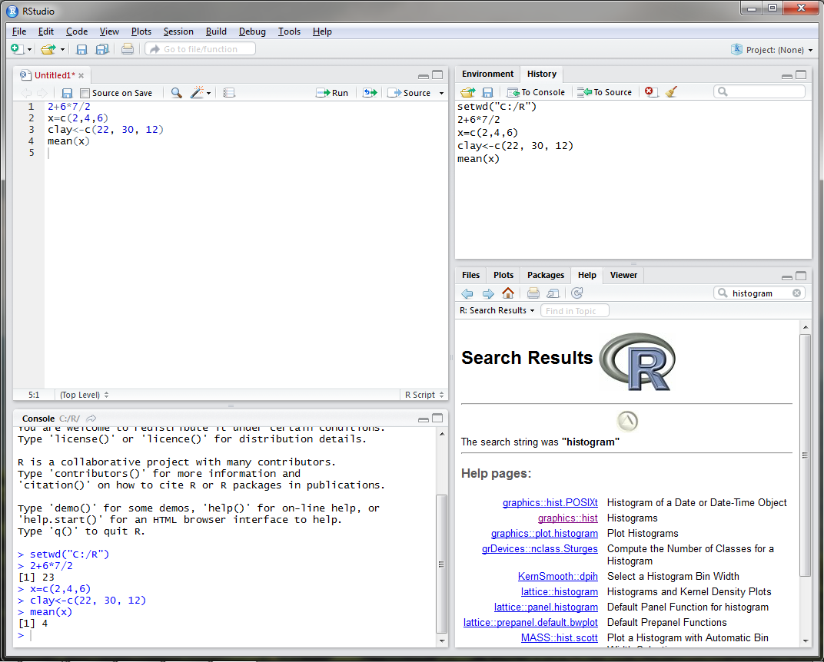
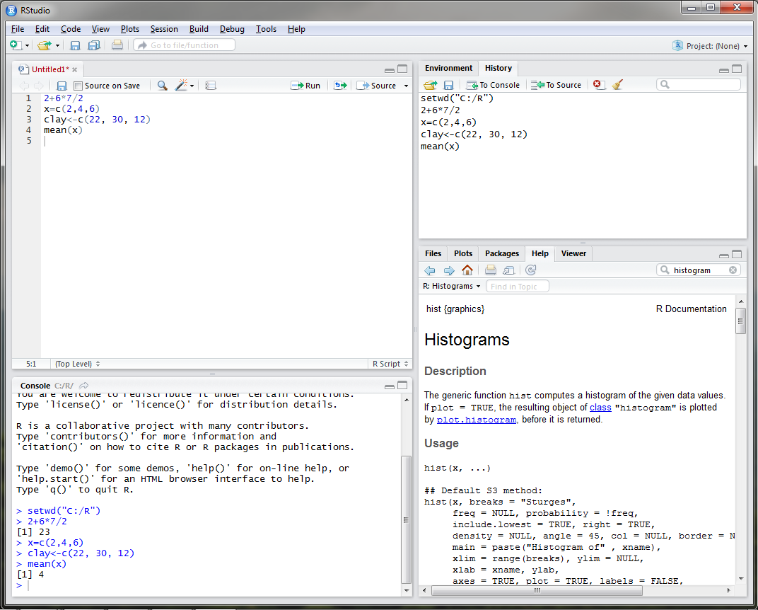
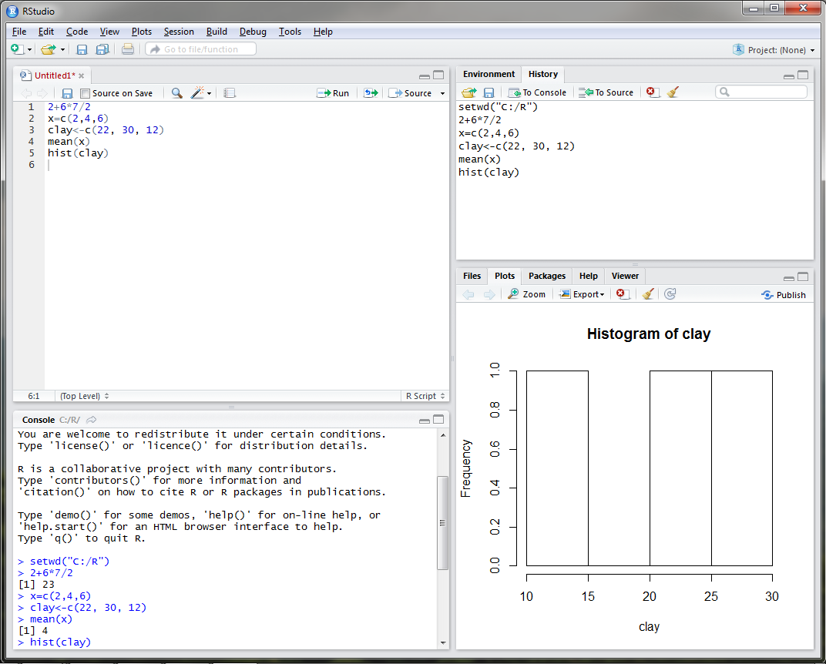
RStudio
Notes:
What if I wanted to view the distribution of clay content? What function would I use? If I was unsure, I could use the Help tab in the bottom right and search for histogram.
-Click-
If I click on the graphics: hist link, a webpage describing the hist function appears.
-Click-
If I execute the hist command for clay content, you can see that a plot is generated in the plot tab in the bottom right.

Slide 26
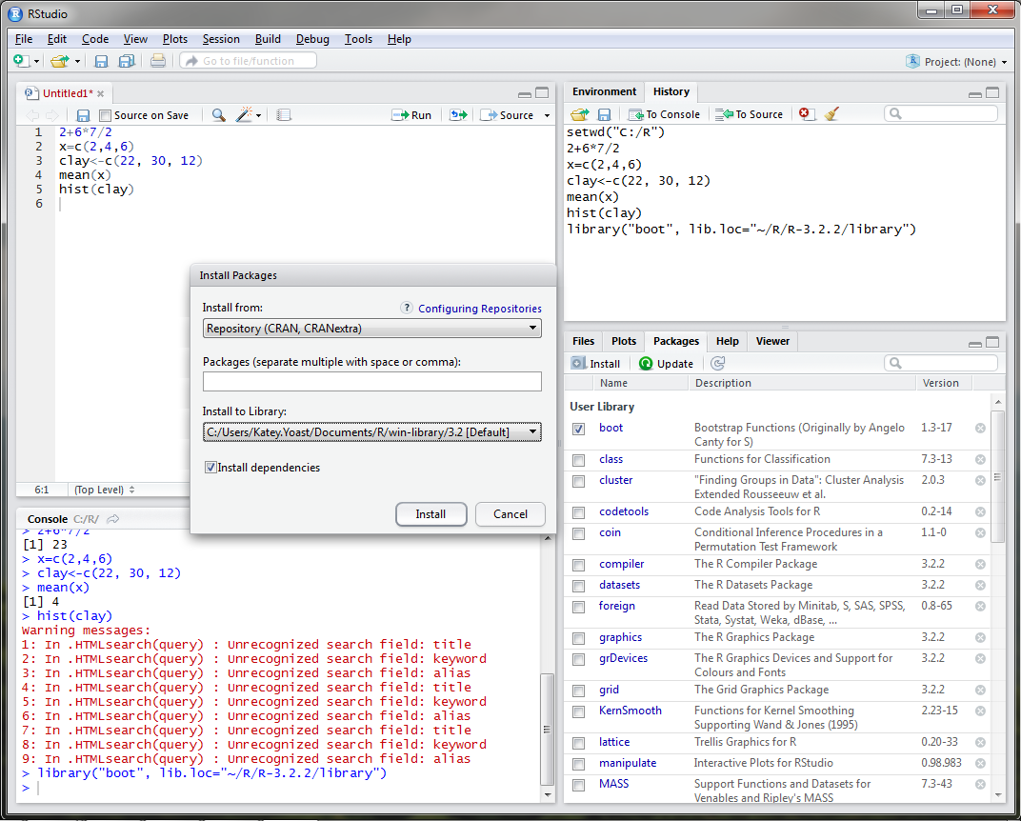
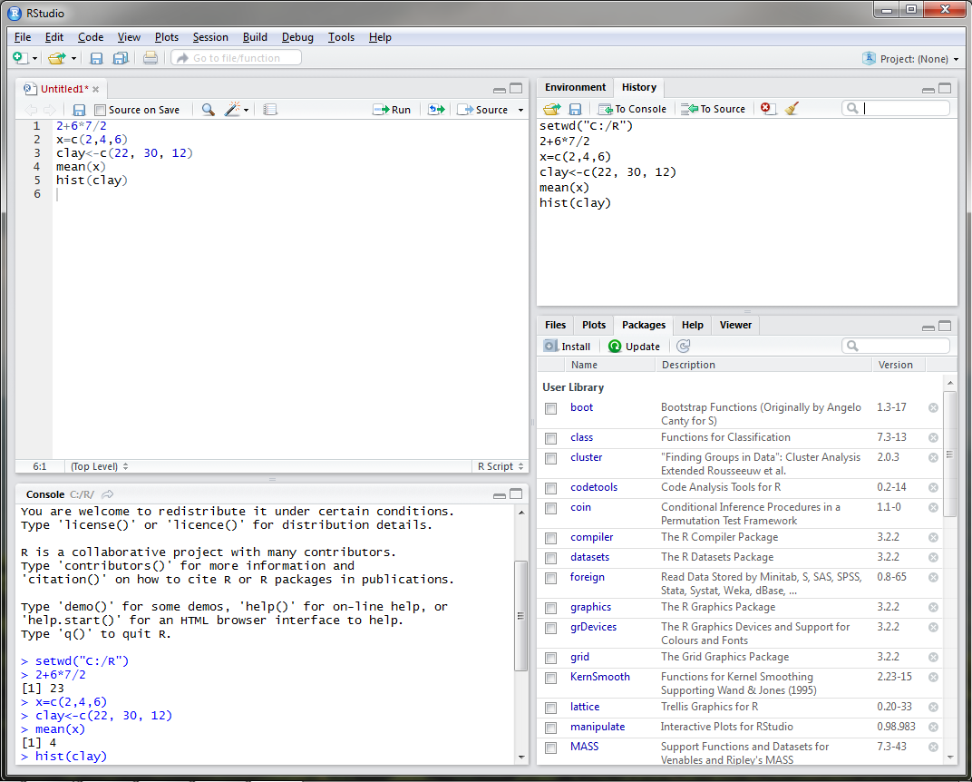
RStudio – Installing Packages
Notes:
One thing that I have yet to mention is that both R programs are equipped with base packages that contain functions such as hist and mean. Packages are simply collections of code developed by R users. There are currently over 7,300 packages developed for use in R. For user convenience, RStudio developed a Packages tab in the lower right window that lists all of the packages that have been installed. In order to utilize these packages, the user must load them either by using the library() function or by checking the box next to the package name in the Packages tab.

Slide 27
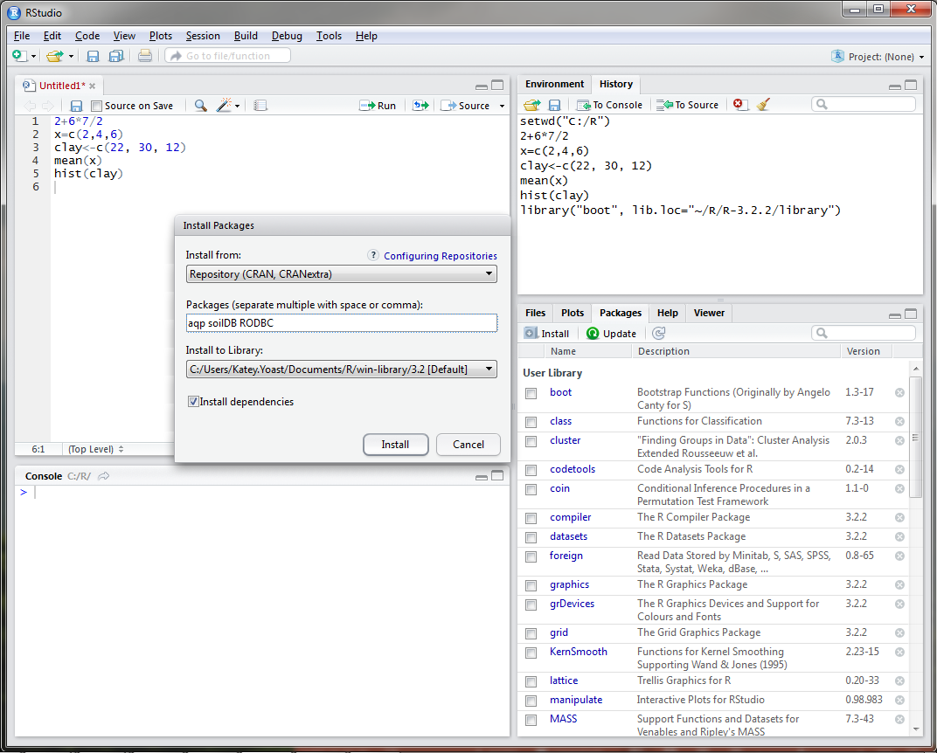
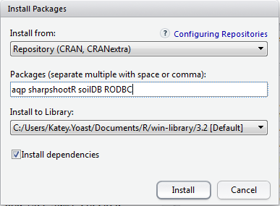
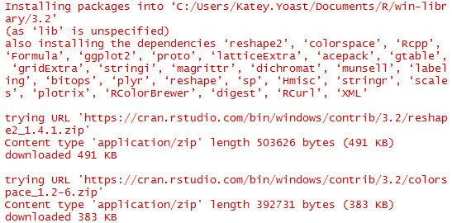
RStudio – Installing Packages
Notes:
It may be necessary to install several packages that are not listed under the Packages tab. With no packages selected, click on Install under the Packages tab. In the packages text line, we will type four packages that have been used for soil survey applications, the aqp, sharpshootR, soilDB, and RODBC packages. Packages only need to be installed the first time you use them on your machine.
-Click-
Notice that the packages that we have installed depend and utilize many other packages that were also installed on our machine. It is important to always check the install dependencies box when installing a package in R.
AQP – visualization, aggregation, classification
soilDB – access to commonly used soil databases
SharpshootR – misc. soil survey specific functions
RODBC - ODBC Database Access

Slide 28
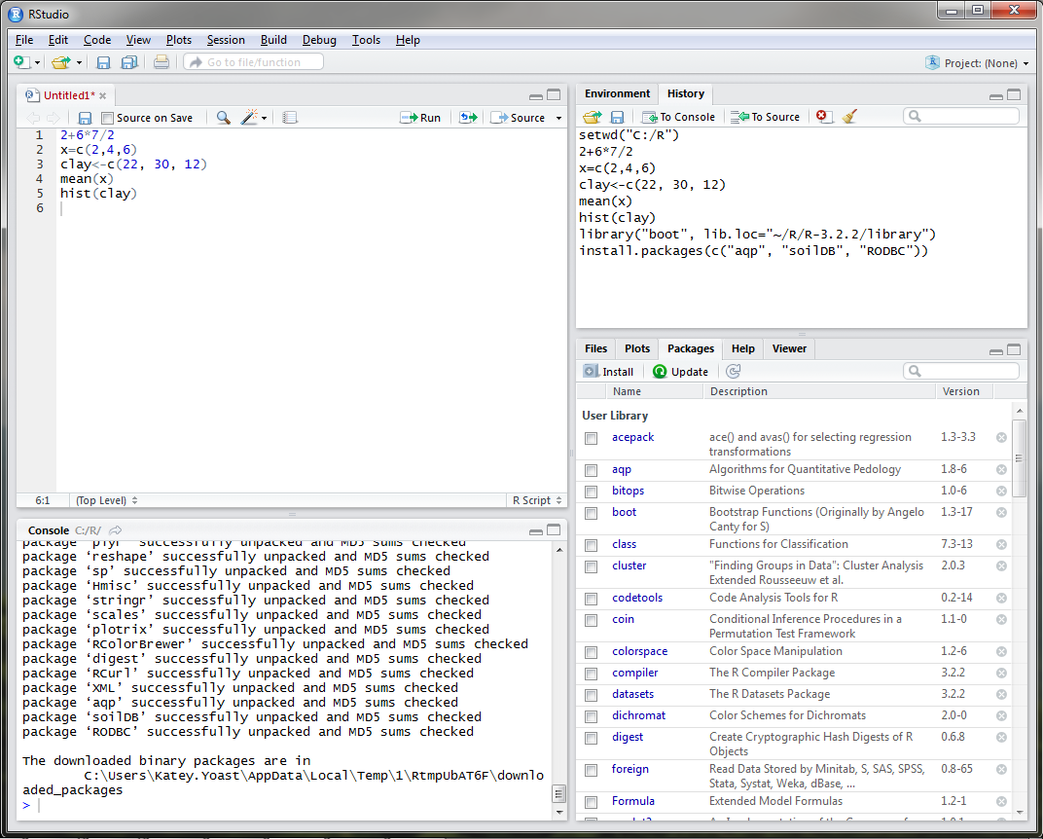
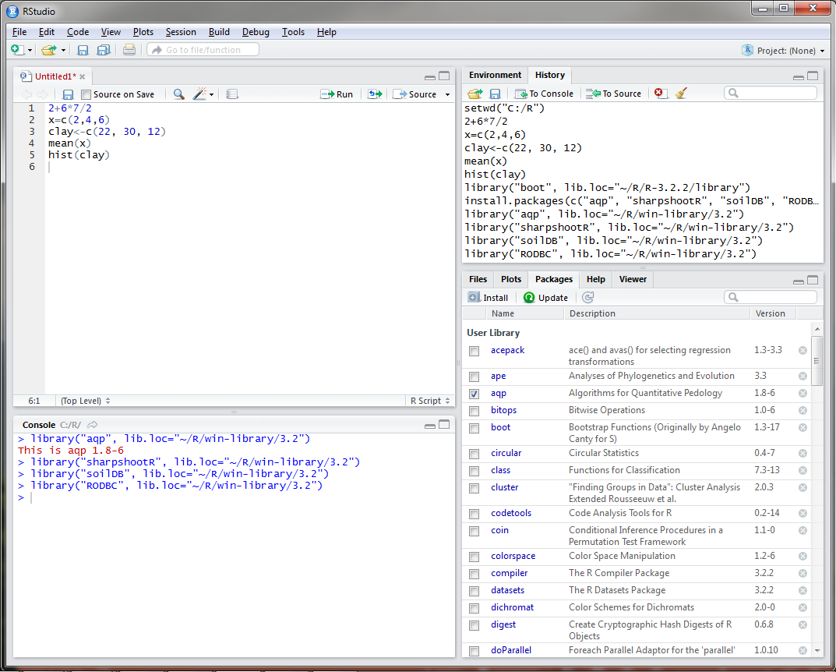
RStudio – Installing Packages
Notes:
Once installed, the packages are added to the Package tab in the bottom right corner. You can update packages when necessary by clicking on the Update icon in the Packages tab. Updates are available fairly often depending on the package, so it is important to keep packages updated. Every time you open RStudio, you will need to load the packages that you are going to use during your R session by checking the box next to the package name.
All packages in R are required to meet certain standards set by The Comprehensive R Archive Network, including documentation, sample datasets, and examples. Once you find a package that will accommodate the functions that you wish to run, it is simply a matter of reading the documentation and viewing the examples to understand how to apply the function to your data. Since R is an open source program, there are a TON of resources available online.

Slide 29
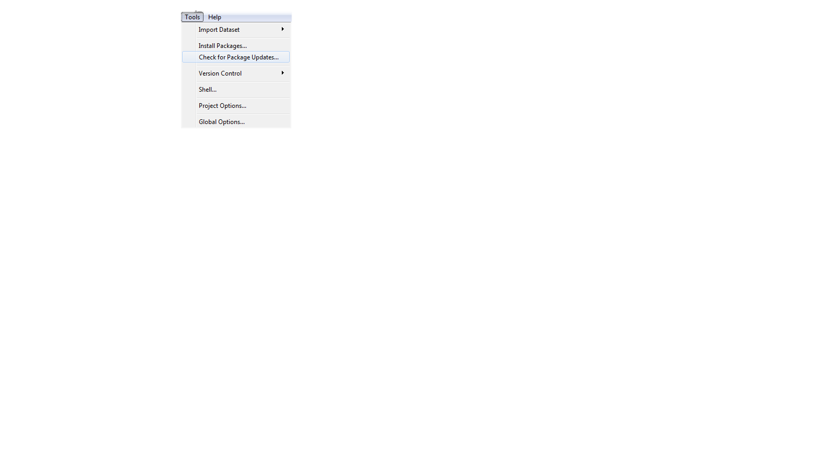
RStudio – Installing Packages
Notes:
You can also install and update packages using the Tools drop down menu.

Slide 30
Pre-course Assignment: Open Database Connection (ODBC)
Links a local NASIS database to R so that pedon and DMU records can be queried with the soilDB package in RStudio.
Only needs to be done once on your machine.
Suggested NASIS queries to run:
Pangaea query POINT - Pedon/Site/Transect by Current Taxon Name. This accepts a Taxon Name, for example, Gauley.
Pangea query POINT - Pedon/Site by Correlated Name.
Pangea query POINT - Pedon/Site/Transects by User Pedon ID (2100 Max).This accepts a comma delimited list, for example, 95IL151005E, 94IL153001, 95IL153001, 92IL163017.
Pangea query POINT - Pedon/Site/Transects by Pedon Rec ID (2100 Max).This accepts a comma delimited list, for example, 44249, 175077, 101806, 44411.
Pangea query POINT - PedonHorizon/Site/Transect by HorizonRecID (2100 Max). This accepts a comma delimited list, for example, 210618, 210619, 853291, 208951.
Notes:
In order to fetch data from NASIS, data must first be in your selected set. The NASIS queries displayed above are suggested by Tom and Stephen for loading data into your selected set.

Slide 31
EXERCISE
https://github.com/ncss-tech/stats_for_soil_survey/blob/master/chapters/1_introduction/1_introduction.md
Notes:
Let's take a 10 minute break and then we will run through some introductory examples in R.

